Slide 1
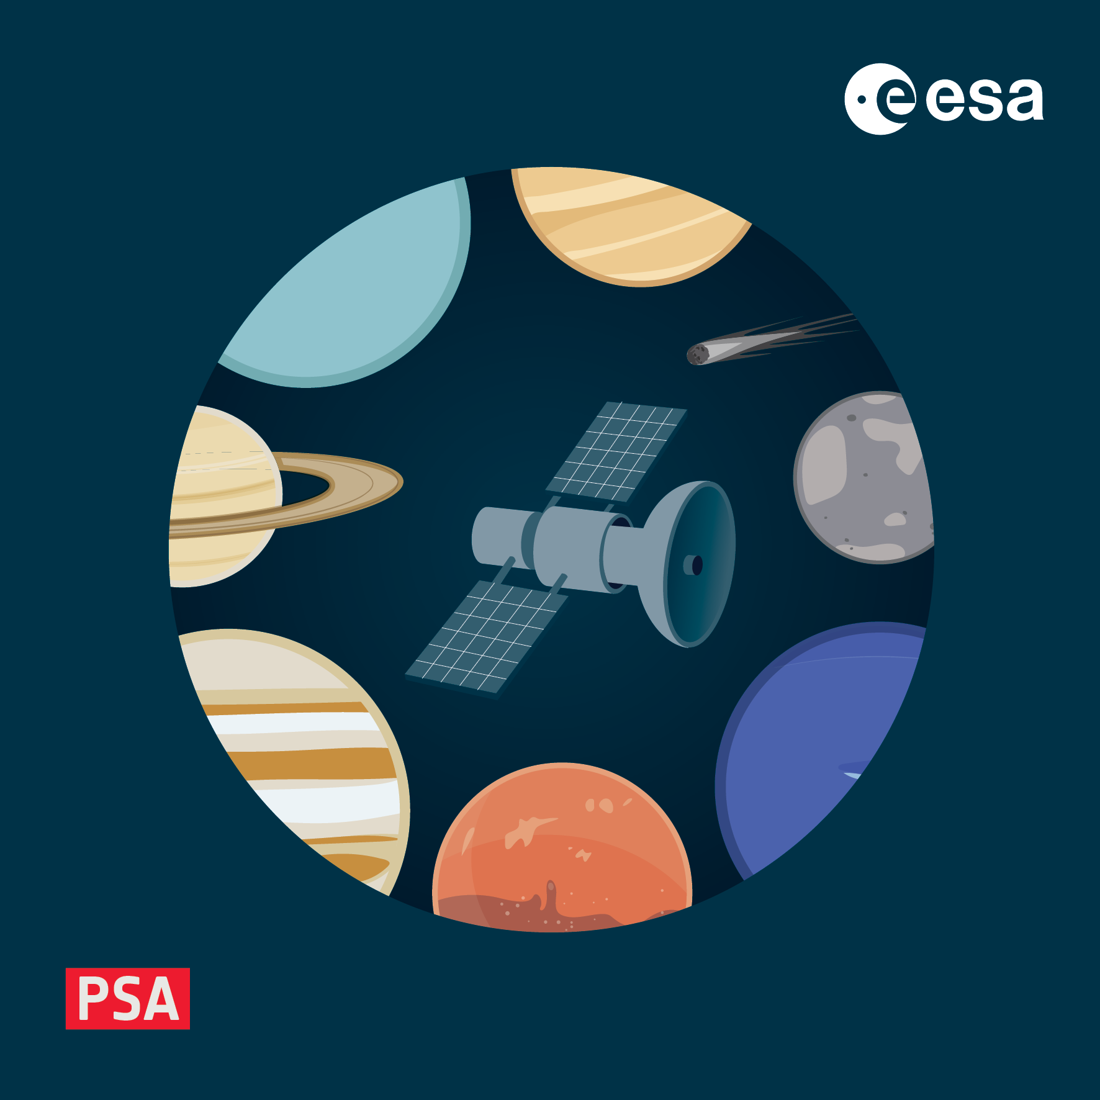
How to Build A Product
4-8 November 2024, ESAC, Spain

Slide 2
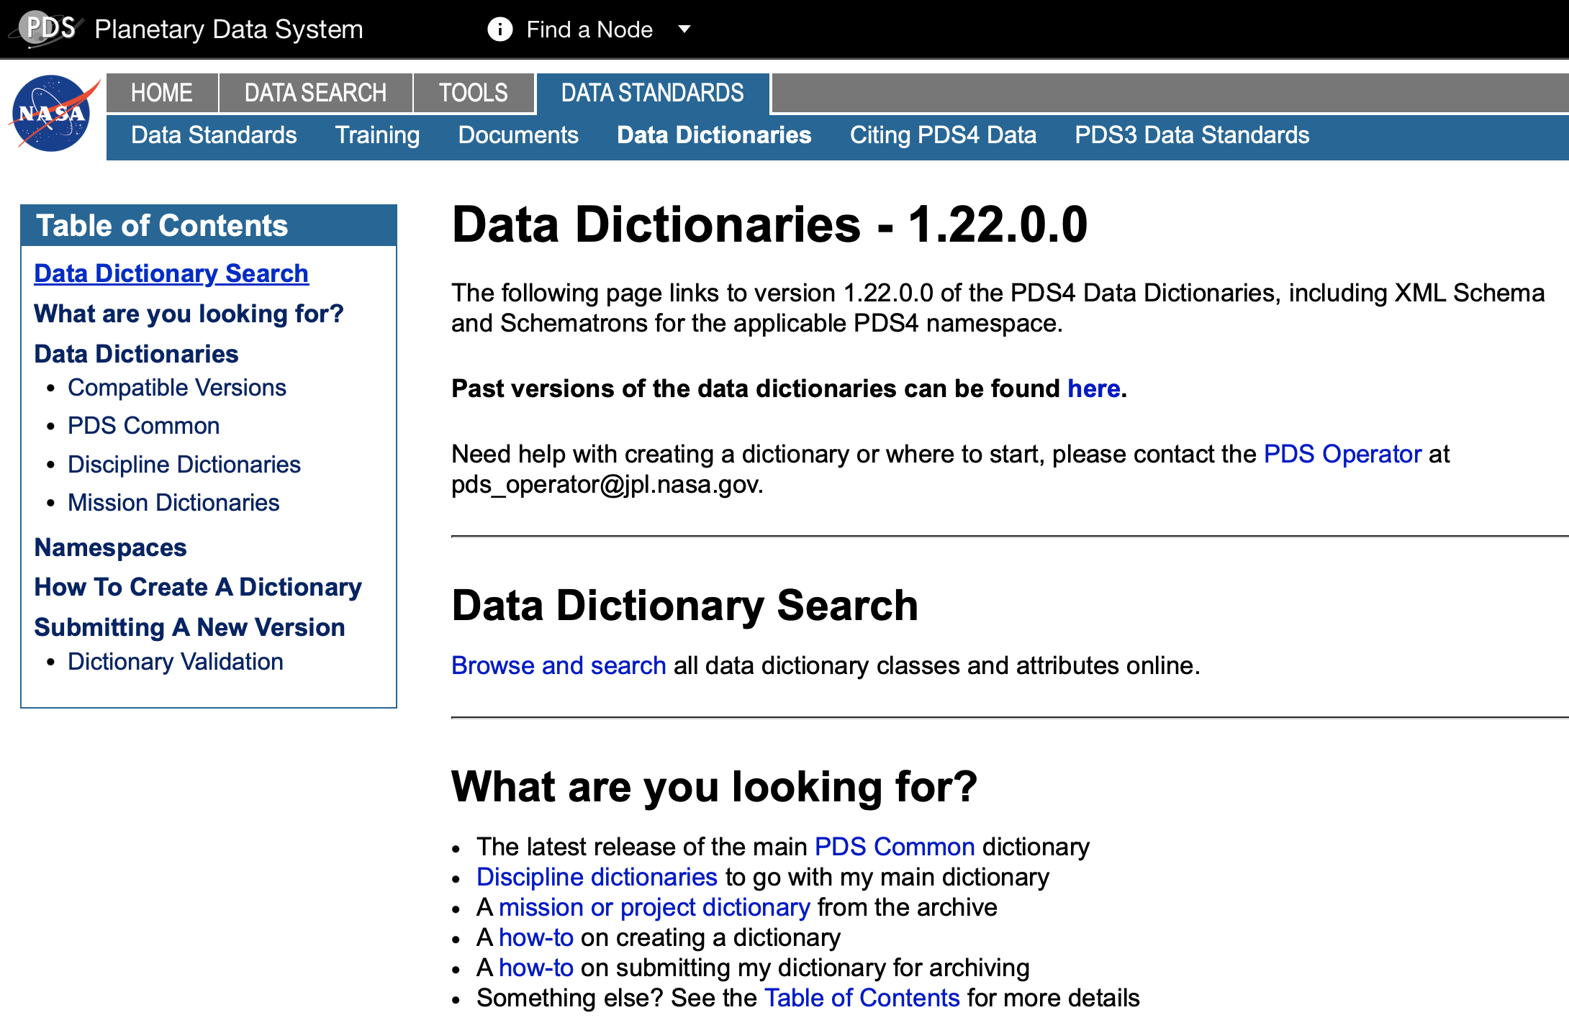
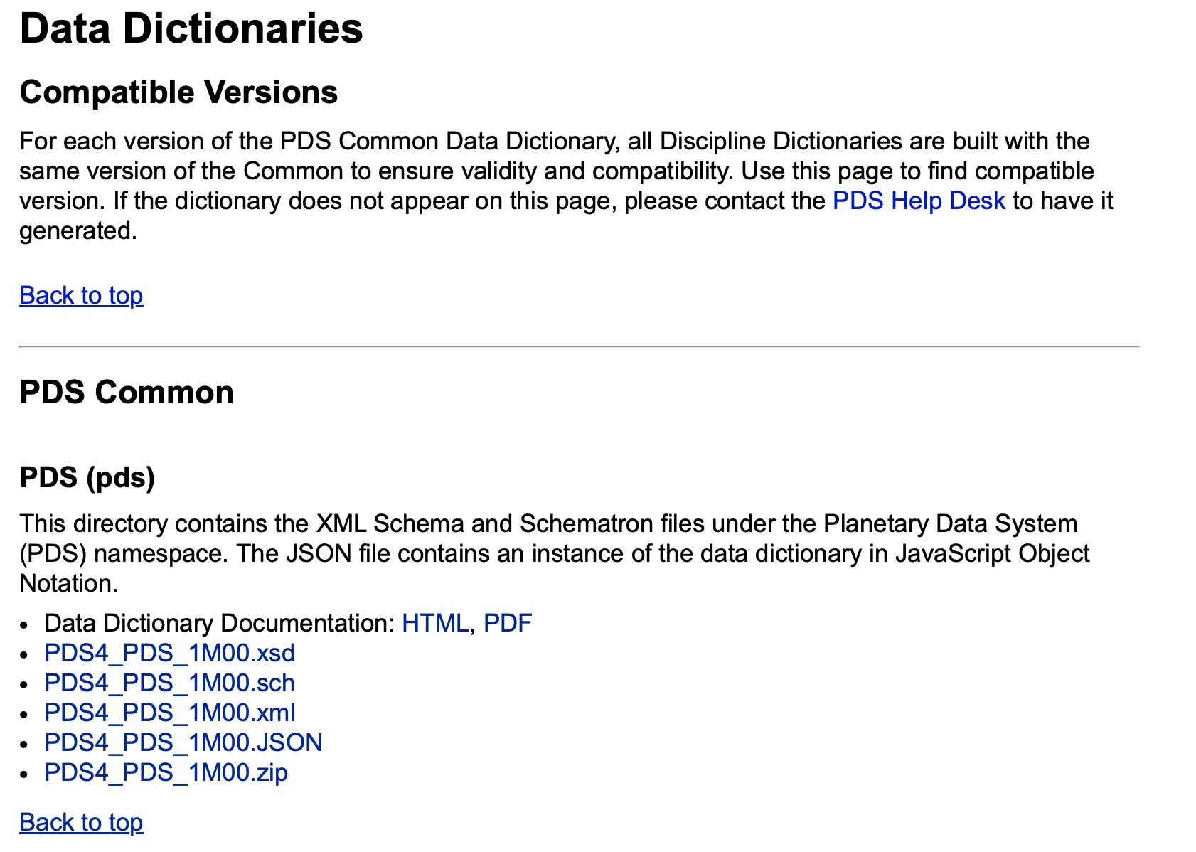
pds.nasa.gov

Slide 3
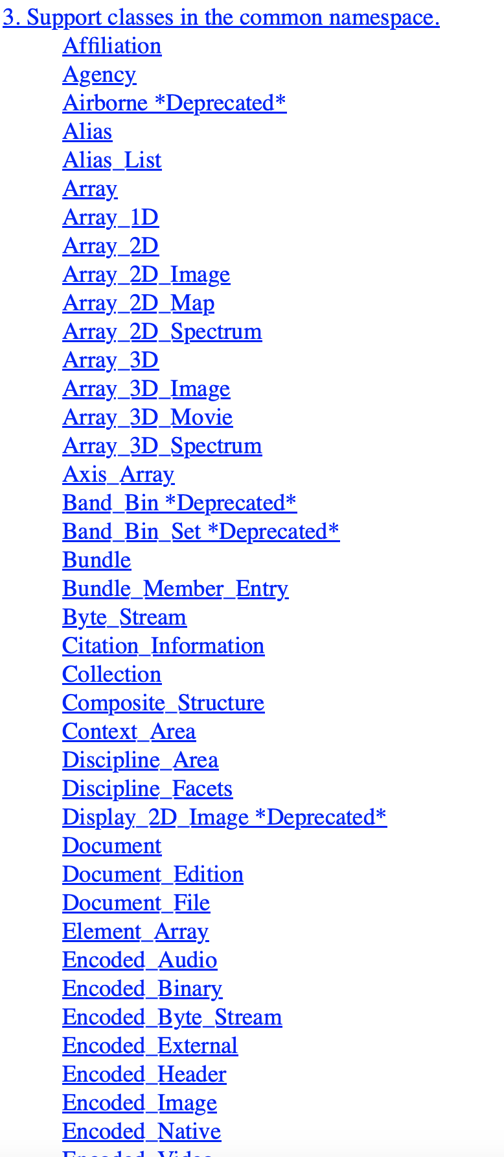
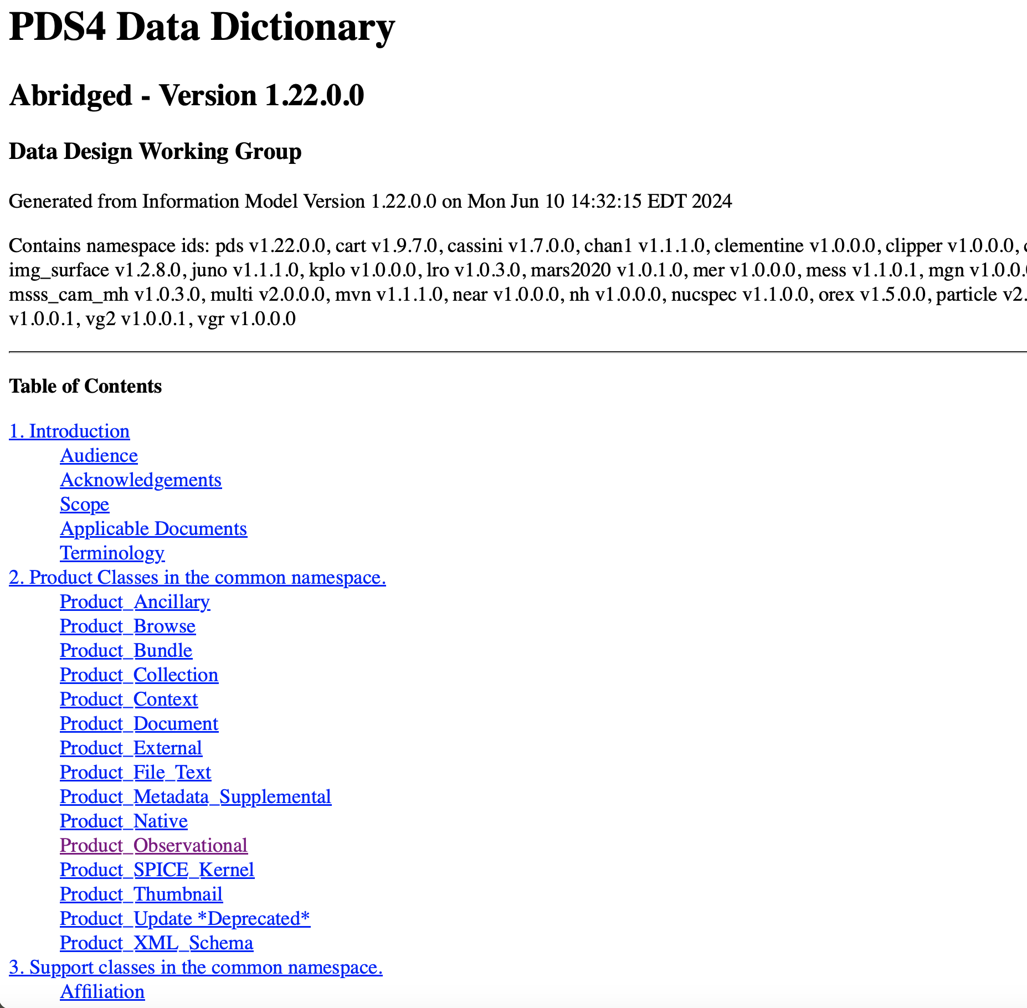

Slide 4
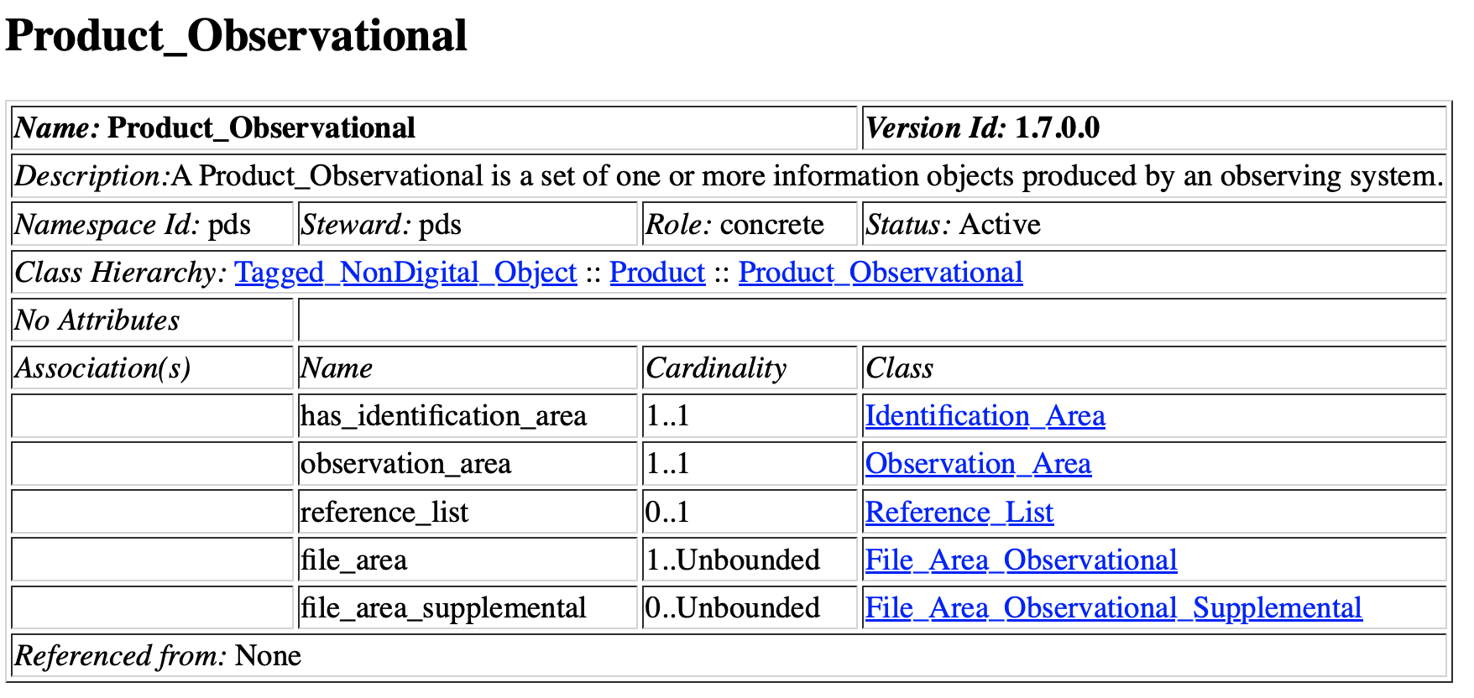
How to Make A Product_Observational Label
Start with the core dictionary…
https://pds.nasa.gov/datastandards/documents/dd/v1/PDS4_PDS_DD_1M00.html
So I have to have an Identification Area, Observation Area and File Area Observational, the rest is optional

Slide 5
Identification Area

Slide 6
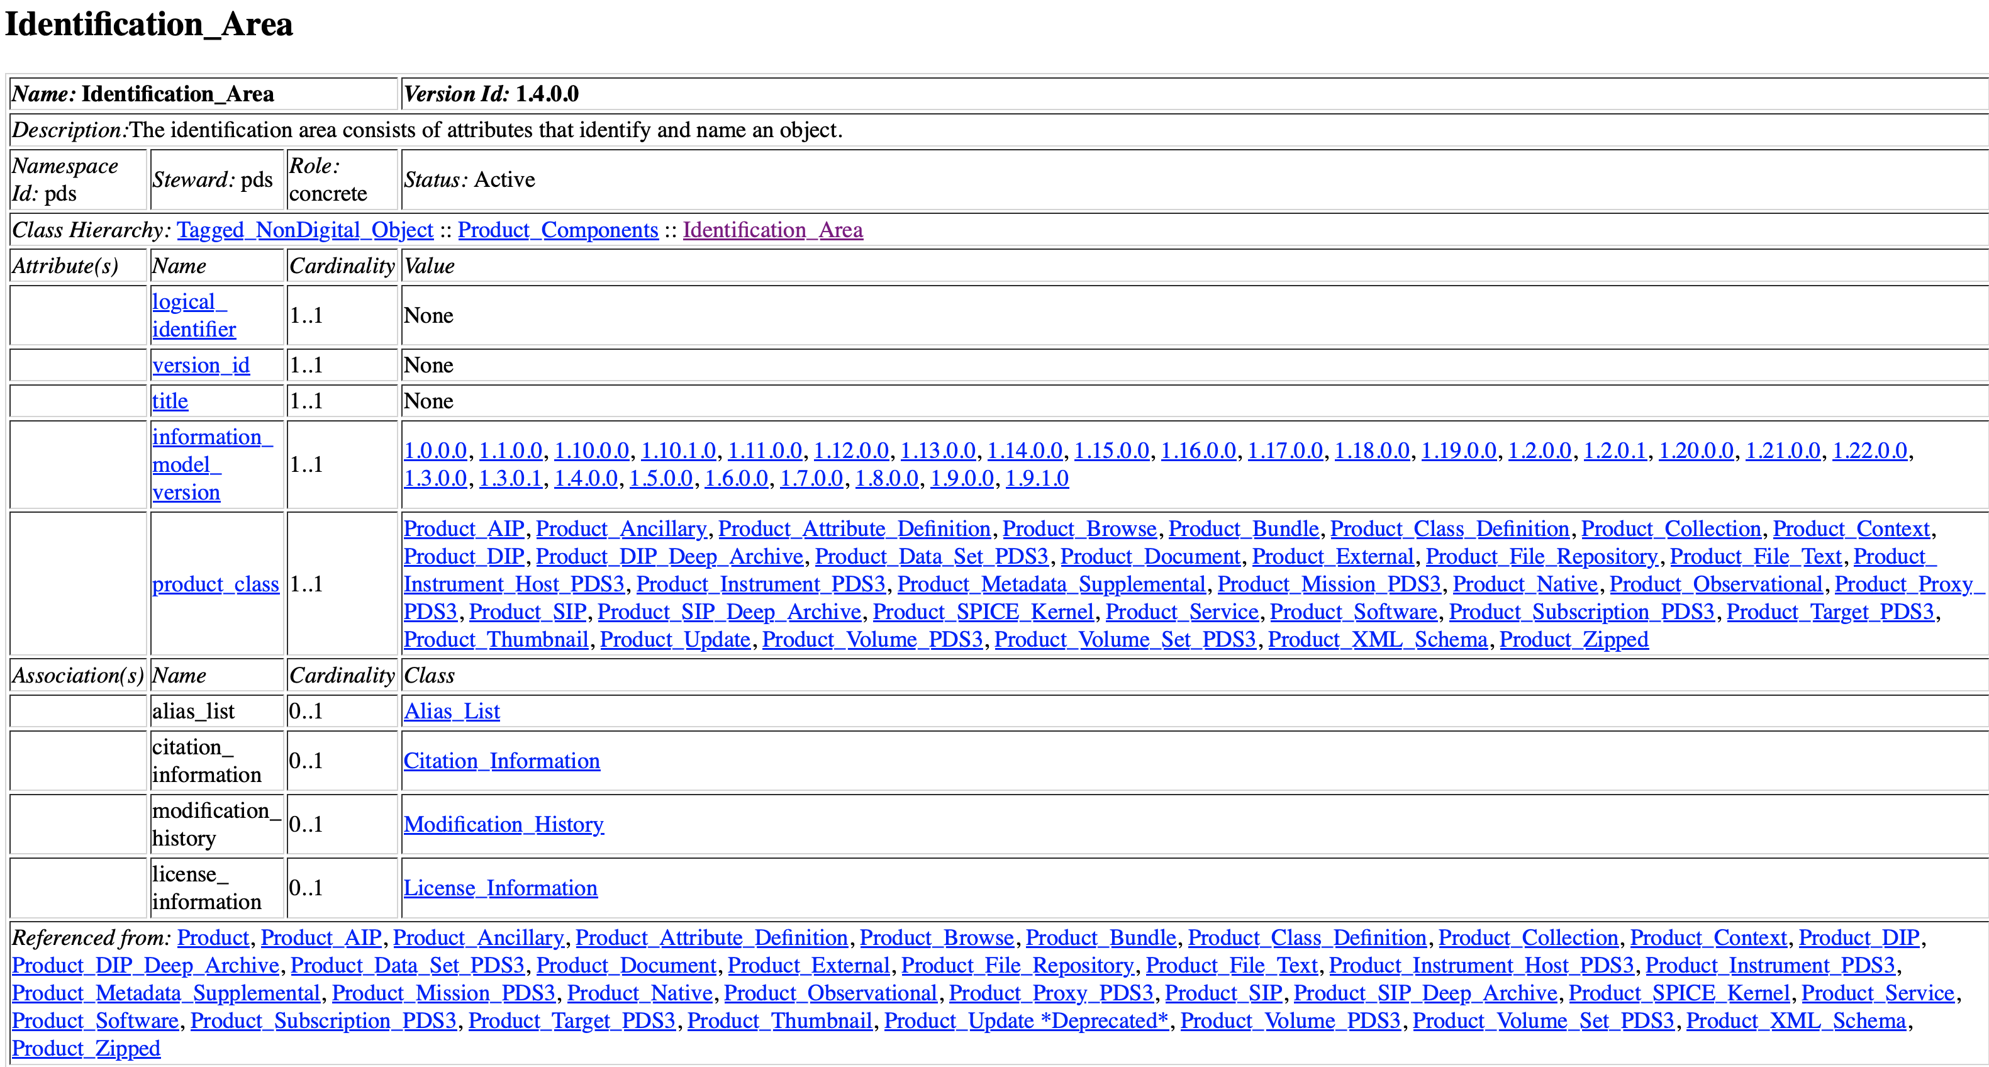

Slide 7
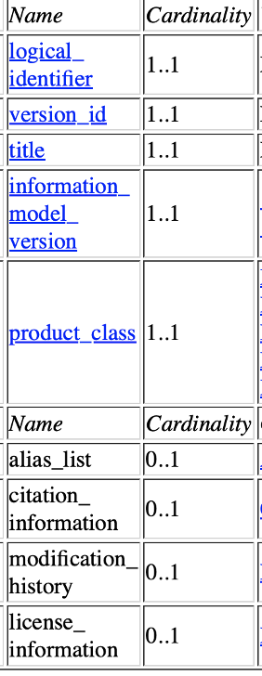
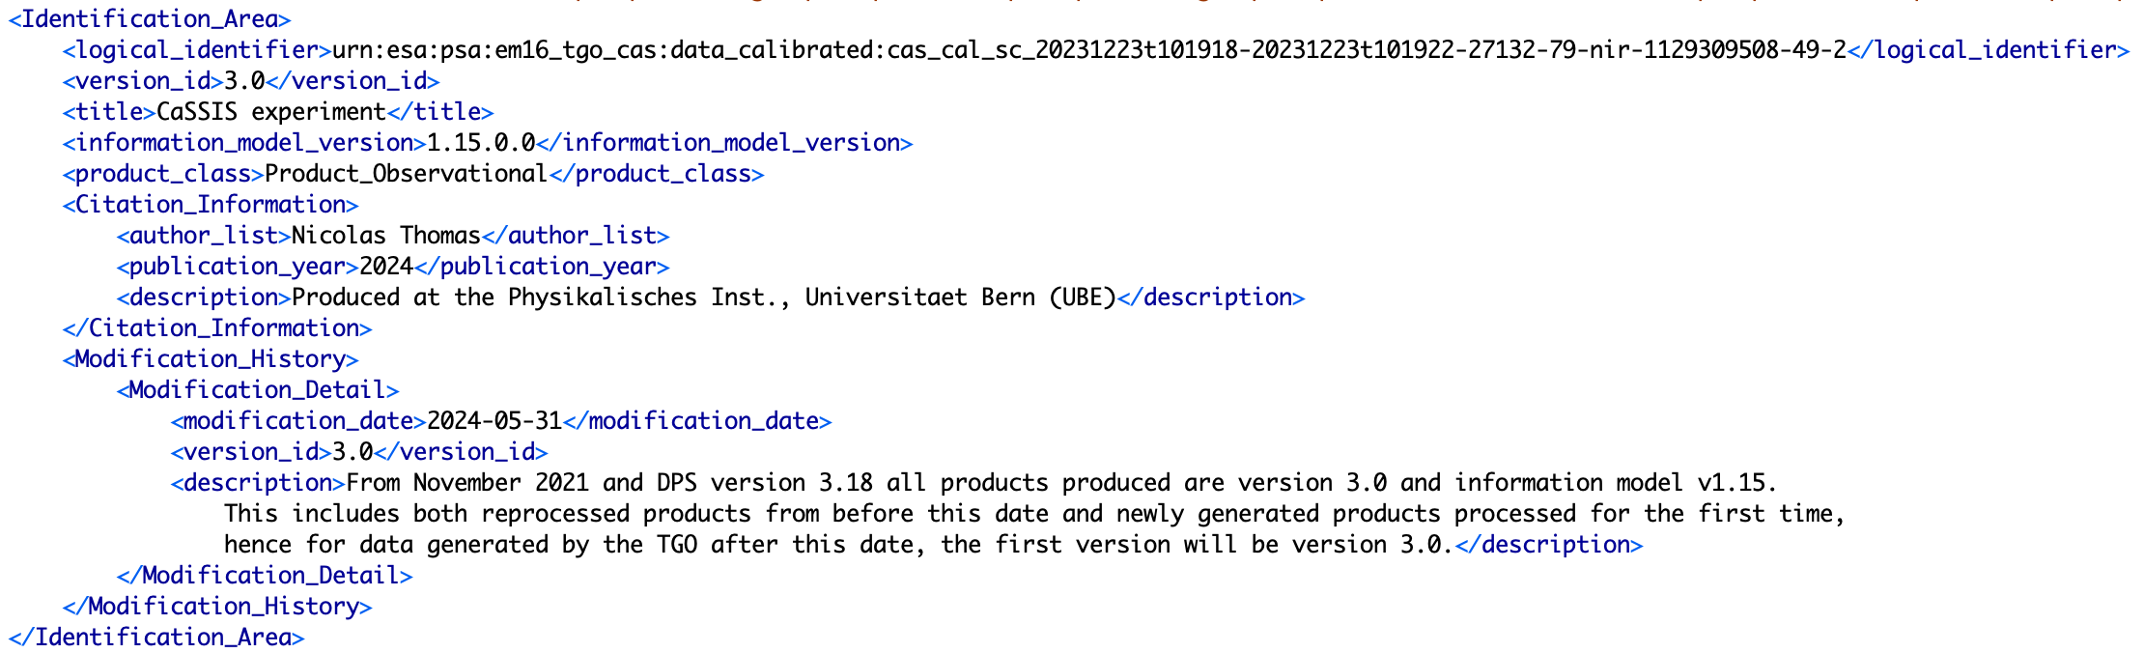
Identification_Area

Slide 8
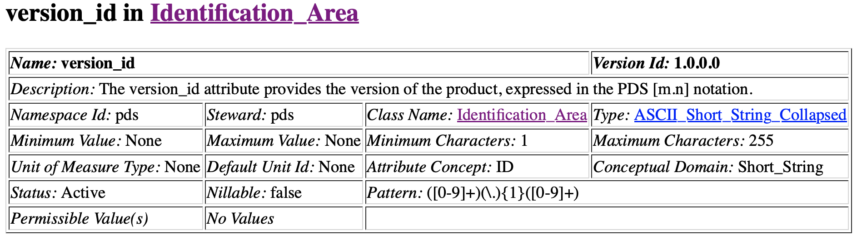

Slide 9
Observation Area

Slide 10
How to Make A Product_Observational Label
Start with the core dictionary…
https://pds.nasa.gov/datastandards/documents/dd/v1/PDS4_PDS_DD_1M00.html

Slide 11
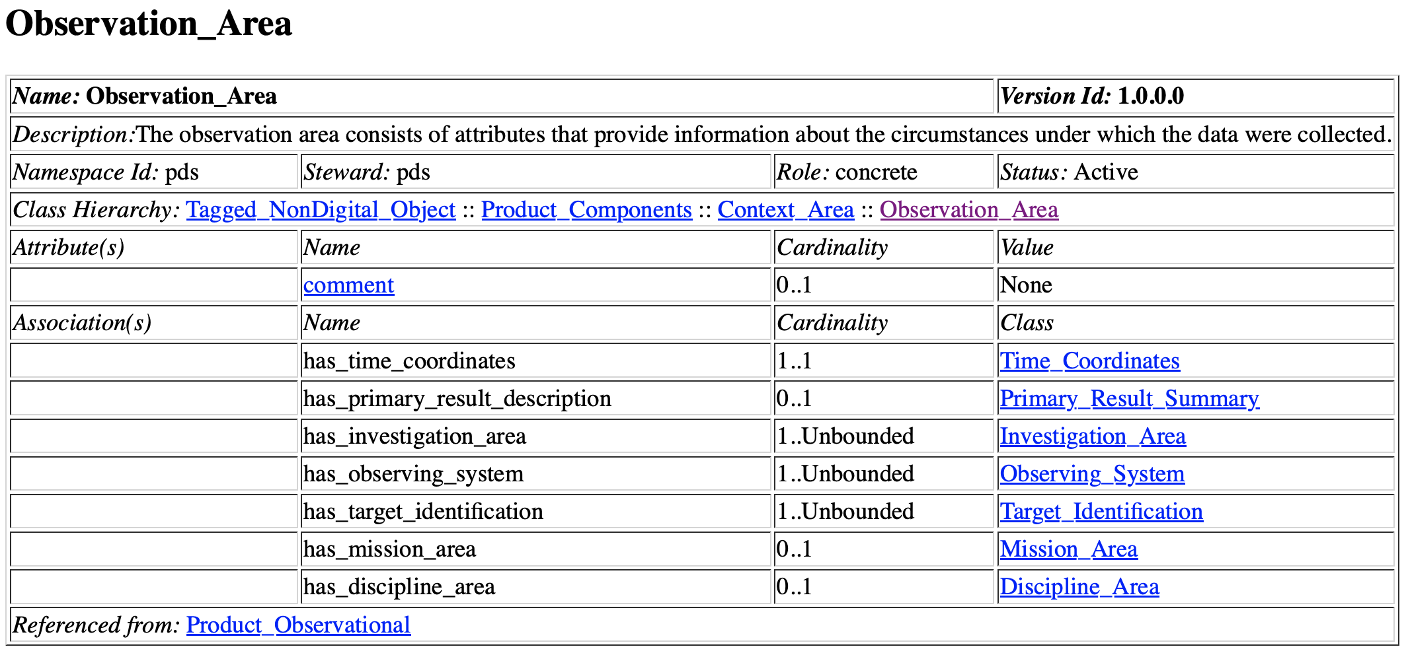

Slide 12
Classes in Observation_Area
Name | Mandatory? | Max | Description
Time_Coordinates | Yes | 1 | Basic Time Information
Primary_result_Summary | No | 1 | Added science information (mandatory in PSA)
Investigation_Area | Yes | Infinite | Points to observatory/mission context file
Observing_System | Yes | Infinite | Points to spacecraft/host context files and instrument context
Target_Identification | Yes | Infinite | Identifies target with reference to a context file
Mission_Area | No | 1 | Everything from PSA/Mission/Instrument dictionaries
Discipline_Area | No | 1 | Everything from Discipline dictionaries

Slide 13
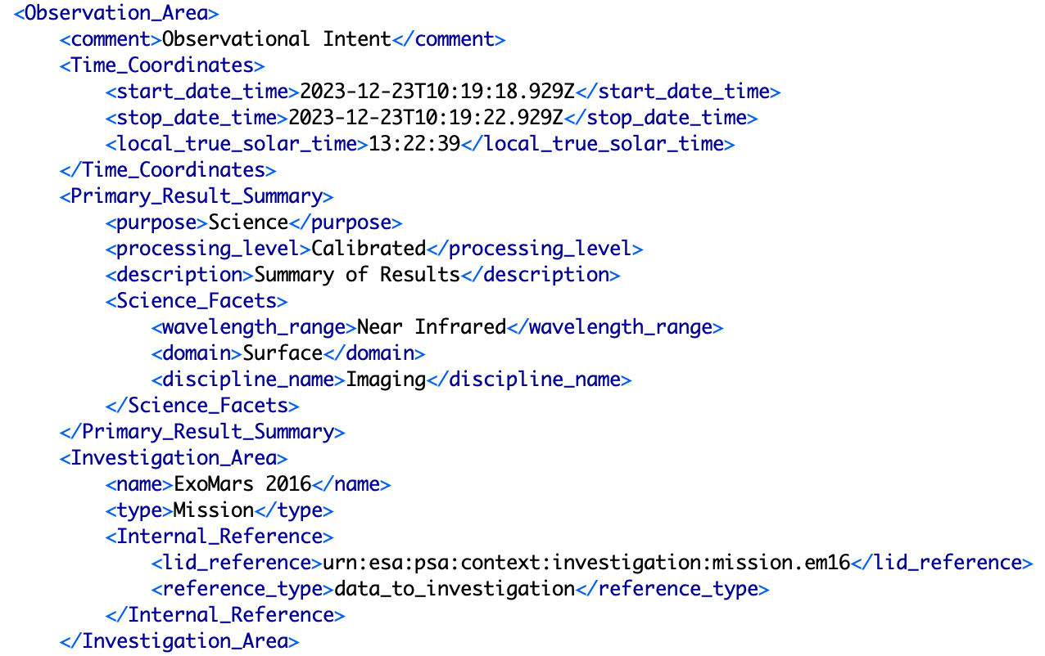
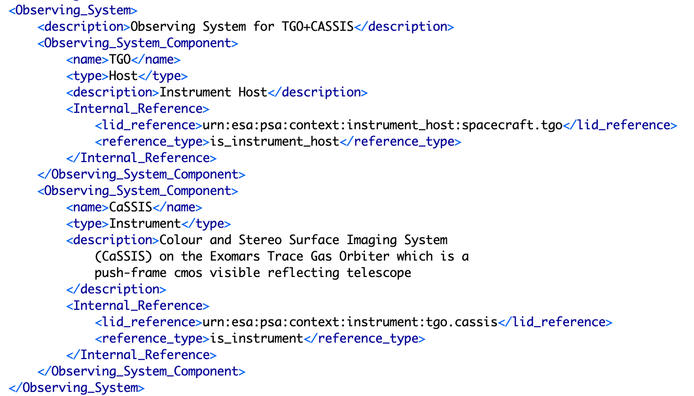
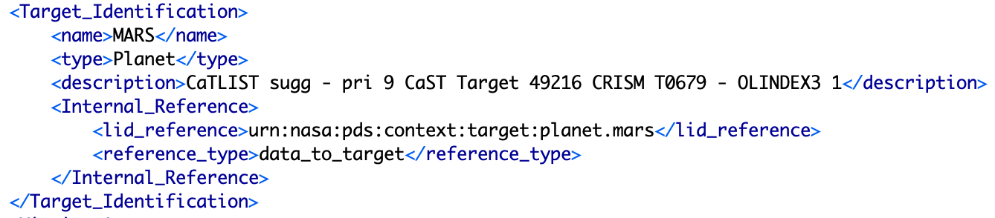
Observation_Area in a TGO CaSSIS Product

Slide 14
Reference List

Slide 15
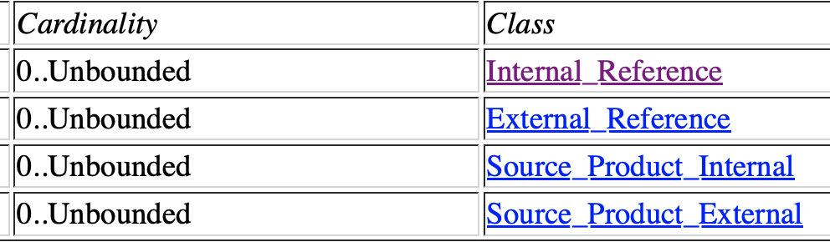
Reference List

Slide 16
Internal Reference and Source Product External
<Reference_List>
<Internal_Reference> <lid_reference>urn:esa:psa:em16_tgo_frd:document:exm-fr-icd-iki-0086_v2.4</lid_reference> <reference_type>data_to_document</reference_type> </Internal_Reference>
<Internal_Reference> <lid_reference>urn:esa:psa:em16_spice:spice_kernels:mk_em16</lid_reference> <reference_type>data_to_spice_kernel</reference_type> </Internal_Reference>
<Internal_Reference> <lidvid_reference>urn:esa:psa:em16_tgo_frd:data_raw:frd_raw_sc_d_20240505t000000-20240505t235959::4.0
</lidvid_reference> <reference_type>data_to_raw_product</reference_type> </Internal_Reference>
<Source_Product_External> <external_source_product_identifier>PKTTM_420__2024-05-05T000000.000_2024-05-05T235959.999.zip
</external_source_product_identifier> <reference_type>data_to_telemetry_source_product</reference_type> <curating_facility>ExoMars 16 Science Operations Center</curating_facility> </Source_Product_External>
</Reference_List>
Example from a TGO FREND product

Slide 17
External Reference and Source Product Internal
<Internal_Reference> <lid_reference>urn:esa:psa:bc_mpo_sixs:browse_calibrated:six_cal_browse_sixs-p_diagnostic_20221108</lid_reference> <reference_type>data_to_browse</reference_type> </Internal_Reference>
<Internal_Reference> <lidvid_reference>urn:esa:psa:bc_mpo_sixs:data_calibrated:six_cal_hk_sixs-p_20221108::1.0</lidvid_reference> <reference_type>data_to_calibrated_product</reference_type> </Internal_Reference>
<External_Reference> <doi>10.1016/j.pss.2008.11.007</doi> <reference_text> J. Huovelin, R. Vainio, H. Andersson, E. Valtonen, L. Alha, A. Mälkki, M. Grande, G.W. Fraser, M. Kato, H. Koskinen, K. Muinonen, J. Näränen, W. Schmidt, M. Syrjäsuo, M. Anttila, T. Vihavainen, E. Kiuru, M. Roos, J. Peltonen, J. Lehti, M. Talvioja, P. Portin, M. Prydderch, Solar Intensity X-ray and particle Spectrometer (SIXS), Planetary and Space Science, Volume 58, Issues 1-2, 2010, Pages 96-107, ISSN 0032-0633 </reference_text> </External_Reference>
<Source_Product_Internal> <lidvid_reference>urn:esa:psa:bc_mpo_sixs:data_raw:six_raw_sc_sixs-p_diagnostic_20221108::1.0</lidvid_reference> <reference_type>data_to_raw_source_product</reference_type> </Source_Product_Internal>

Slide 18
File Area

Slide 19
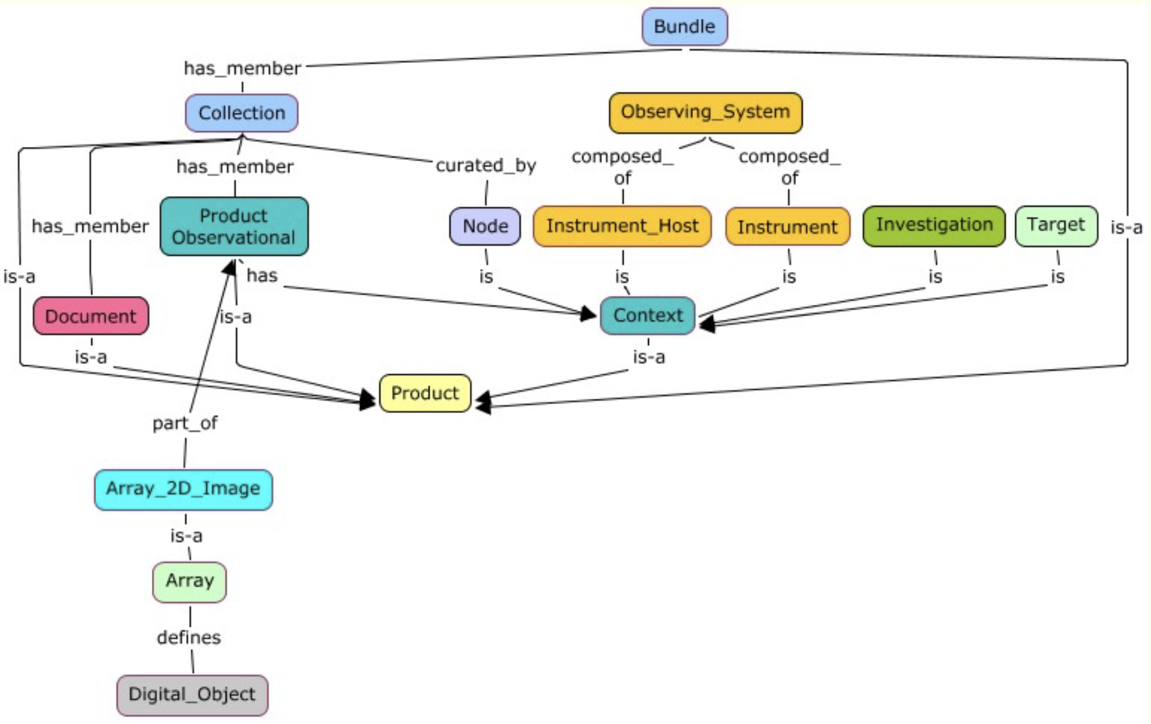
PDS4 Information Model
information model: A representation of concepts, relationships, constraints, rules, and operations to specify data semantics for a chosen domain of discourse. Specifically, the PDS Information Model (IM) is the representation that specifies PDS4.

Slide 20
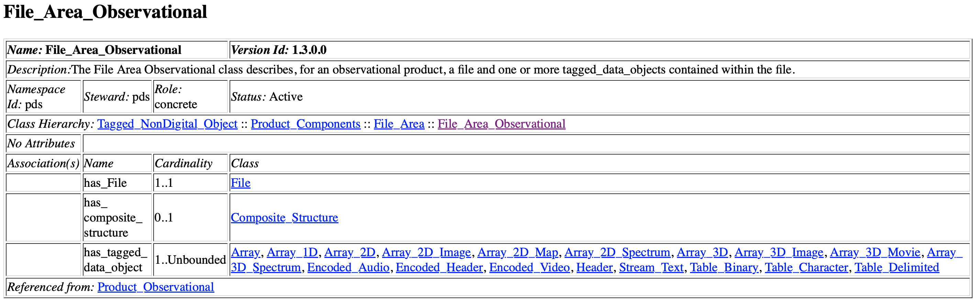
File Area

Slide 21
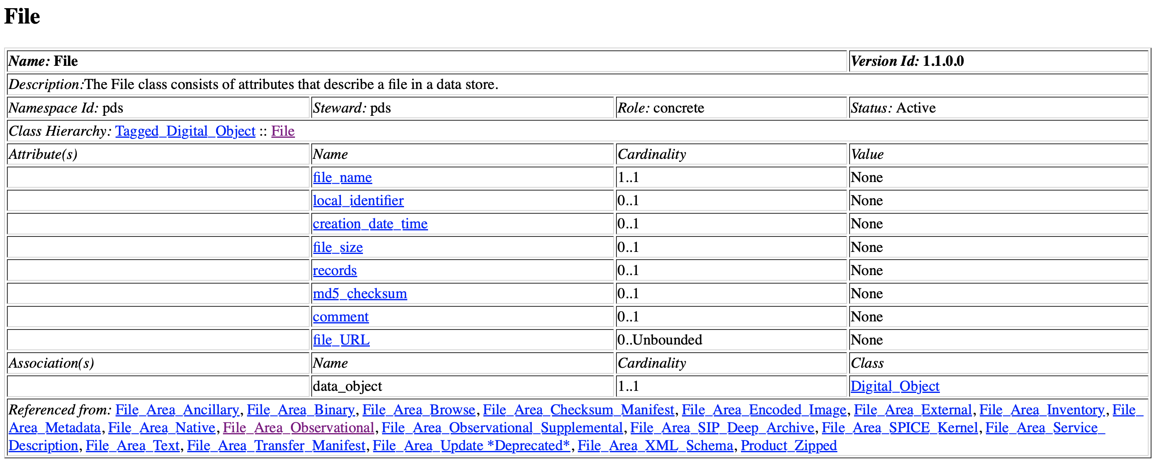
File Area

Slide 22
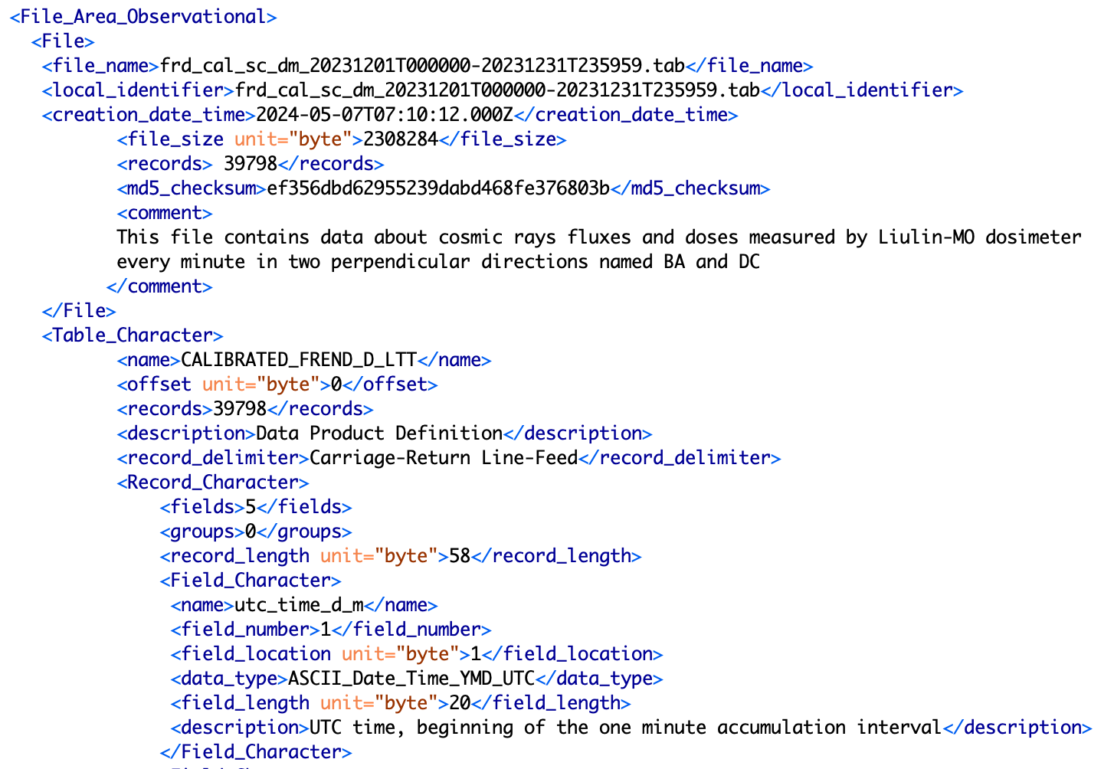

Slide 23
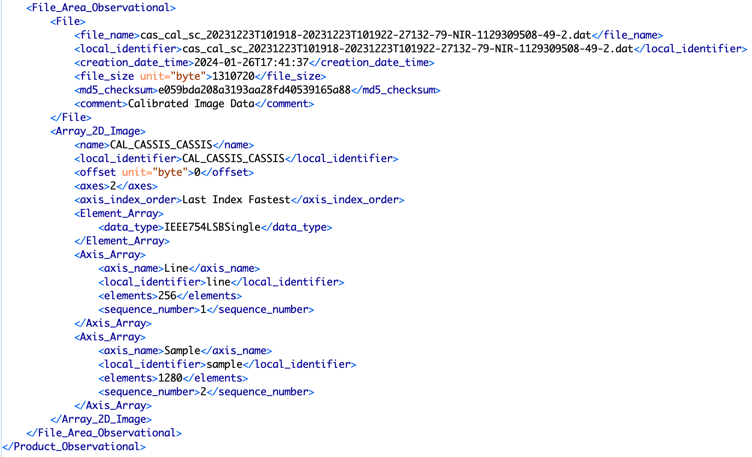

Slide 24
What Else?

Slide 25
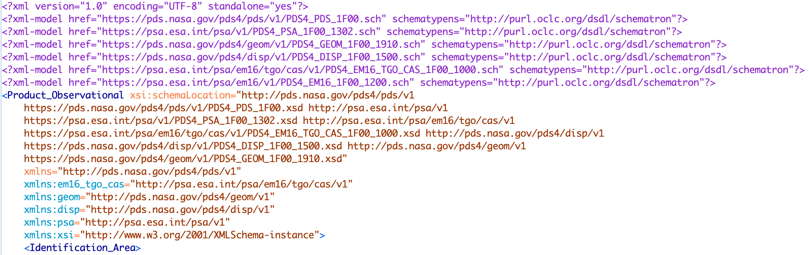
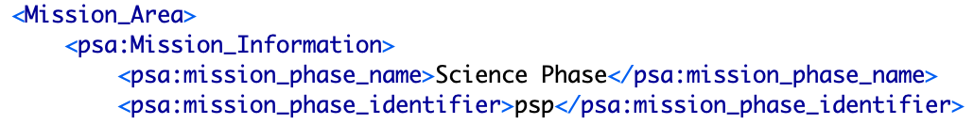
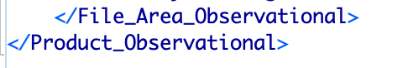
Declarations, Schematron, Schema, namespaces…

